Slide 1
INTRODUCTION TO FET
&
JUNCTION FIELD EFFECT TRANSISTOR (JFET)

Slide 2
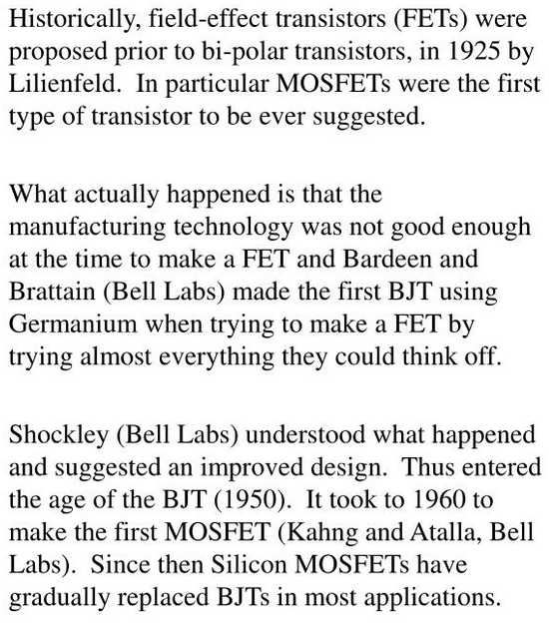
HISTORY OF FET

Slide 3
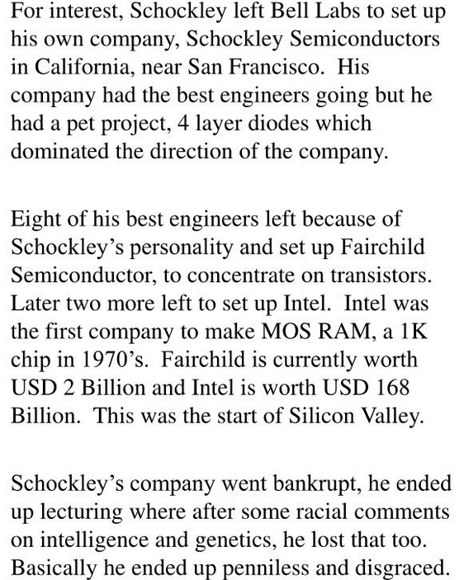

Slide 4
INTRODUCTION
The invention of the BJT has brought a great twist in the modern era of semiconductor technology. This device, along with its field-effect counterpart, known as the field-effect transistor (FET), has had a huge impact on virtually every area of modern life.
Practical field-effect transistors were first made in the form of JFET in 1953 and MOSFET in 1963.
The field-effect transistor has taken various forms like that
The junction field-effect transistor (JFET),
The metal semiconductor field-effect transistor (MESFET),
The metal-insulator-semiconductor field-effect transistor (MISFET),
The metal-oxide-semiconductor field-effect transistor (MOSFET).

Slide 5
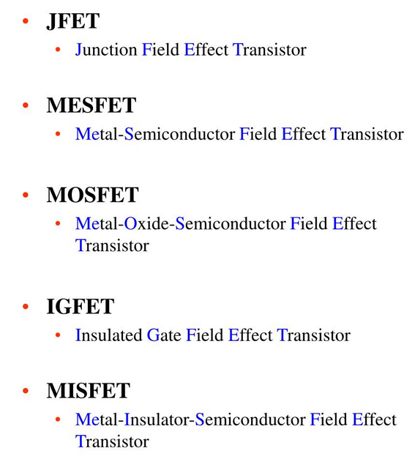

Slide 6
The FET is a single carrier device and is often called the unipolar transistor because the carriers involved in the operation are either electrons or holes.
The FET is also a semiconductor device in which the output quantity is controlled by an electric field, which is often the input quantity.
The phenomenon where the conductivity of the semiconductor is modulated by an electric field applied normally to the surface of the semiconductor is called field effect, and this principle is brought into operation by extending the depletion region deep into the bulk of the semiconductor.
Junction Field-effect Transistor (JFET):- In a junction FET, the control voltage modulates the depletion width of a reverse-biased p –n junction which, in turn, varies with the various parameters of the device.
Insulated Gate Field-effect Transistor (IGFET):- The IGFET is also called the metal-oxide-semiconductor field-effect transistor (MOSFET). In this, the metal gate electrode is separated from the semiconductor by an insulator.
Metal-semiconductor Field-effect Transistor (MESFET):- If the MOS junction is replaced by a direct metal-semiconductor contact, i.e., a Schottky barrier, it is called metal-semiconductor FET (MESFET). A MESFET is similar to a JFET except for the following differences:(i) It has a single gate (ii) The gate is formed by a metal-semiconductor junction

Slide 7
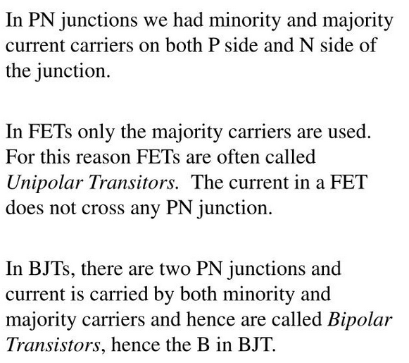
BJT Vs FET

Slide 8
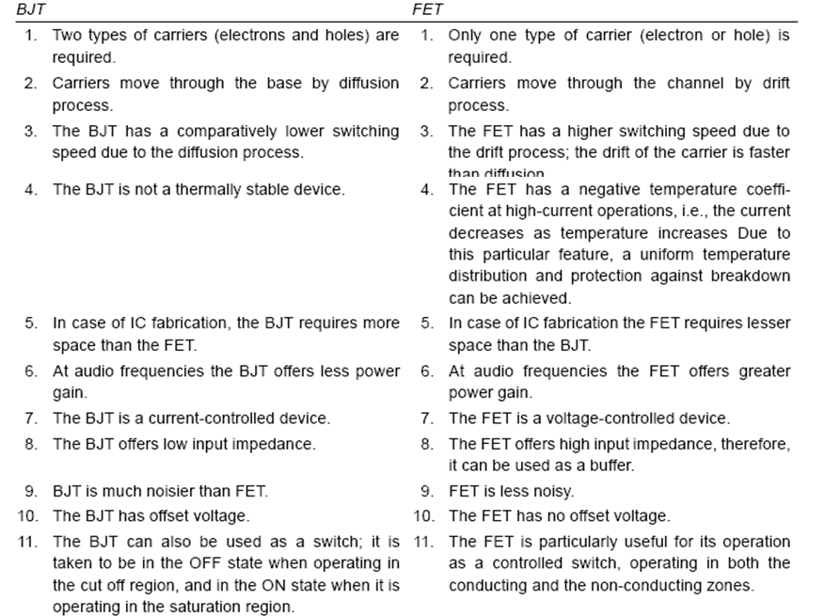

Slide 9
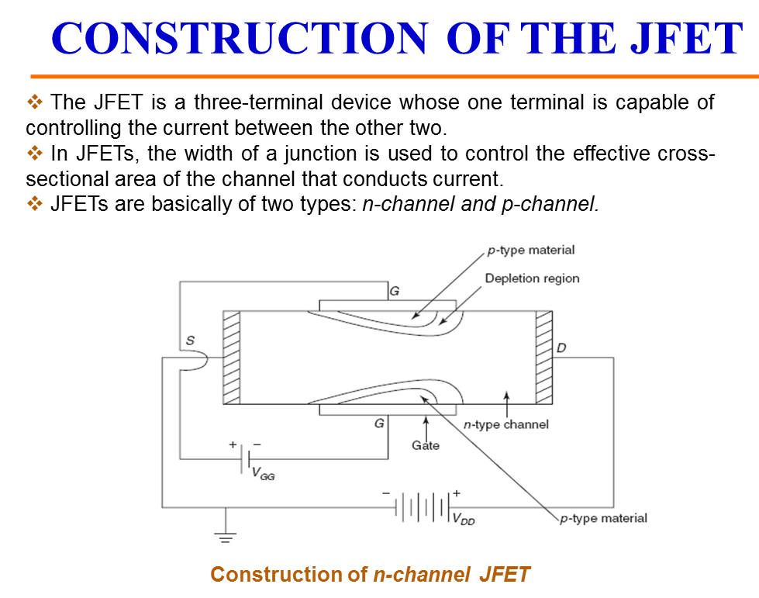

Slide 10
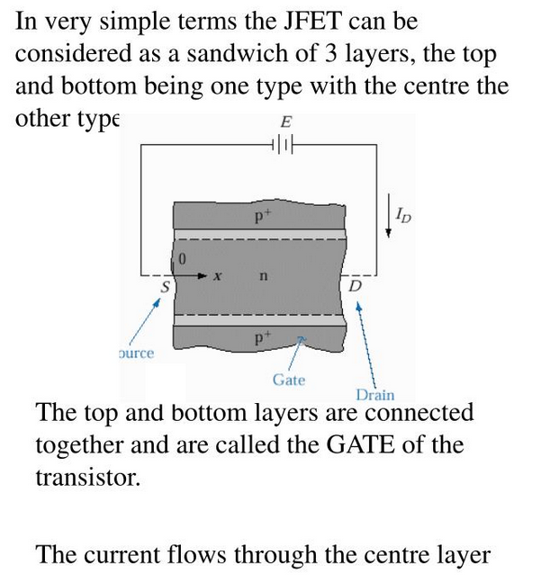
JFET

Slide 11
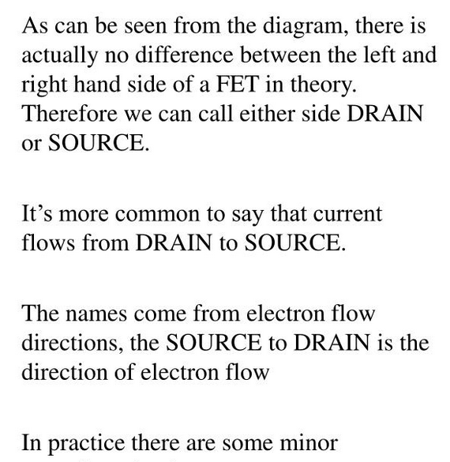

Slide 12
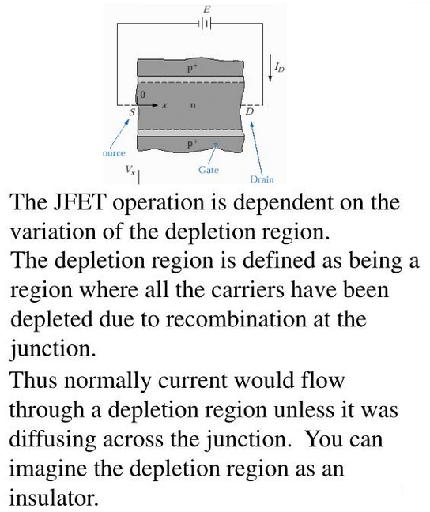

Slide 13
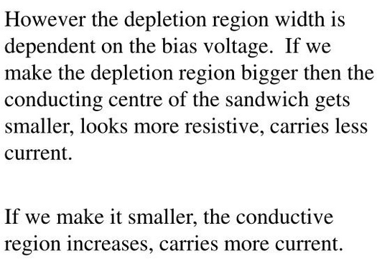

Slide 14
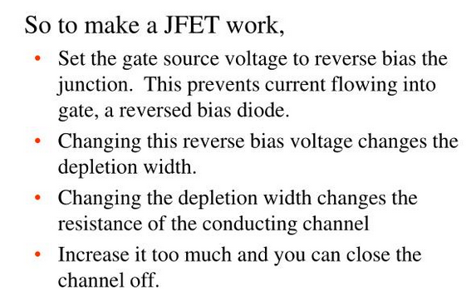

Slide 15
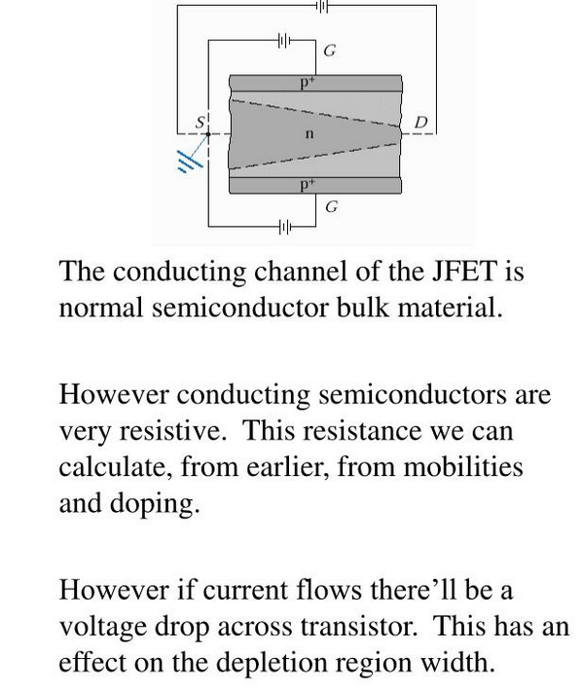

Slide 16
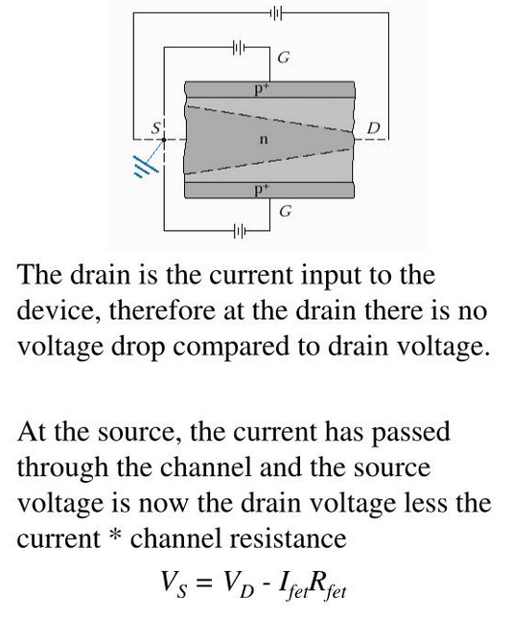

Slide 17
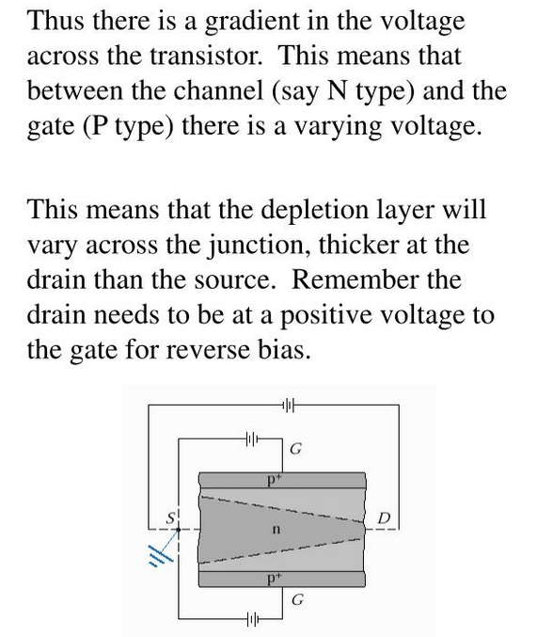

Slide 18
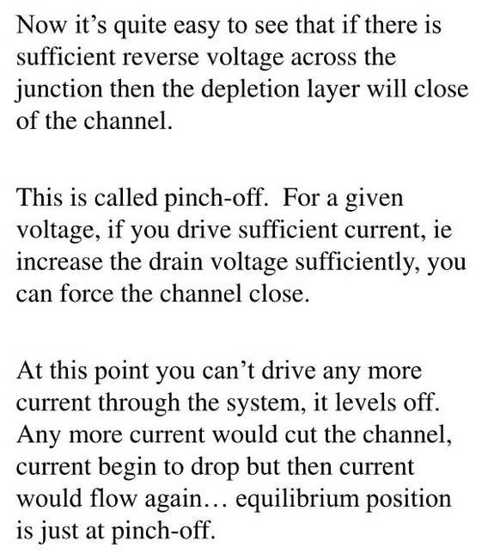
PINCH-OFF IN JFET

Slide 19
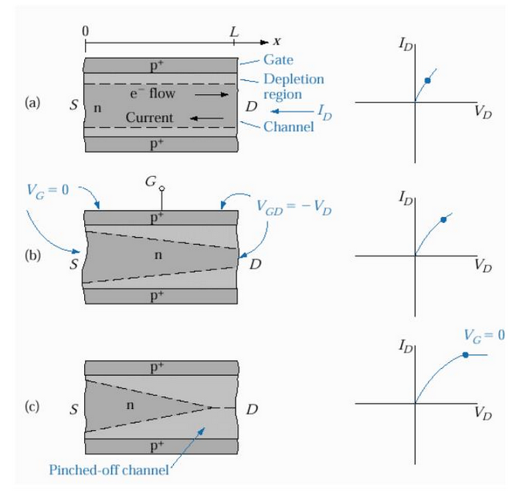

Slide 20
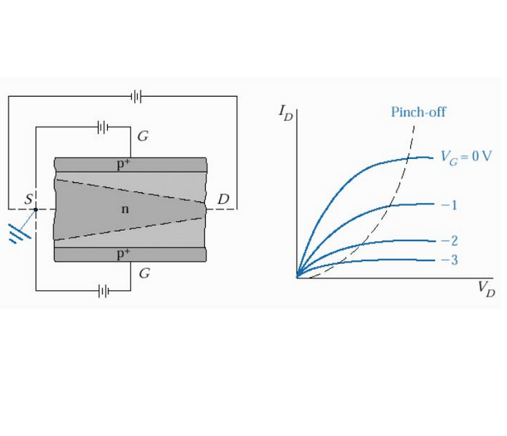
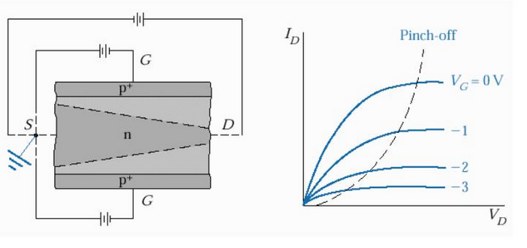

Slide 21
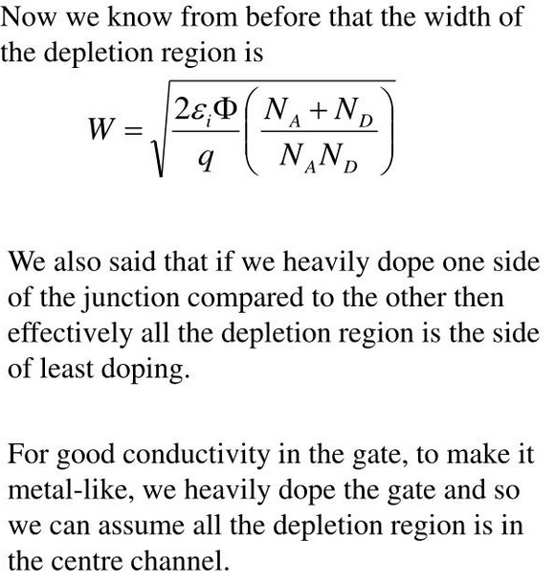

Slide 22
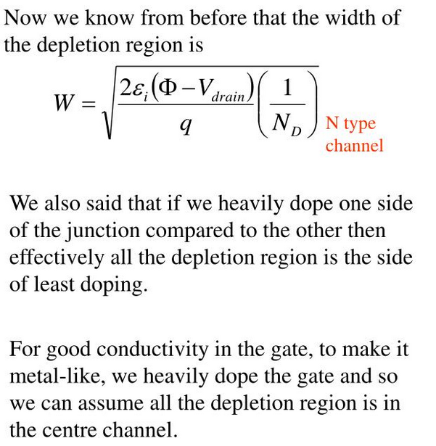

Slide 23
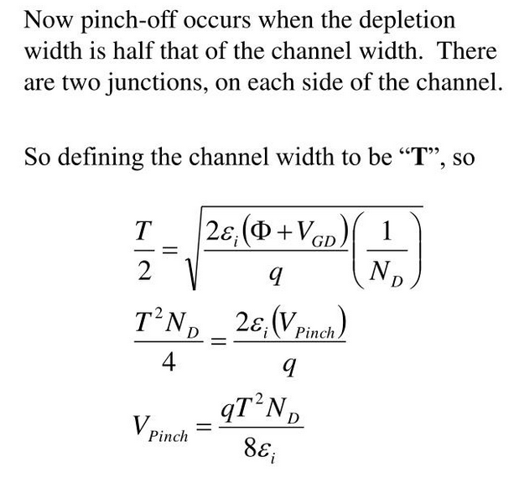

Slide 24
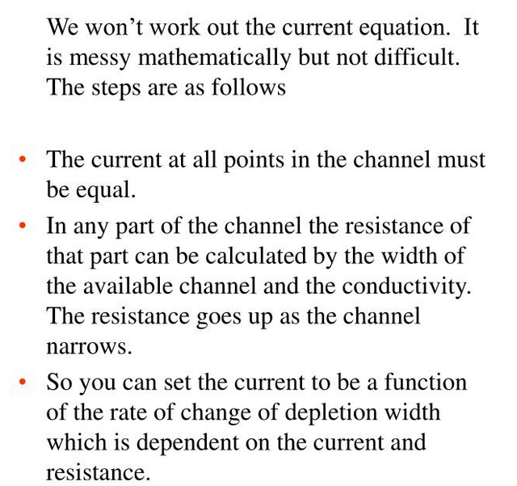
JFET-CHANNEL CURRENT

